Slide 1


Slide 2
Data Mutation
Creating, Updating & Deleting Data

Slide 3

CRUD
Recall the acronym “CRUD” from earlier lectures:
C - Create
R - Read
U - Update
D - Delete
We have been reading data
Time to learn how to C, U & D as well...
Notes:
Can be found online… but I can’t link to it

Slide 4
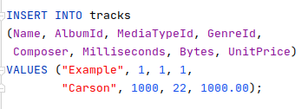
Create
Creating data in SQL is done with the INSERT statement
Unsurprisingly, INSERT inserts data into a table
The basic form is INSERT INTO <table> (<col1>,<col2> ,..) VALUES(<val1>,<val2>,...);
Notes:
Can be found online… but I can’t link to it

Slide 5
Create
Note that when we inserted data into the table, we auto-generated a new ArtistId
If you are inserting data into a database from a programming environment, you need to know the ArtistID!
Notes:
Can be found online… but I can’t link to it

Slide 6

Create
Unfortunately there is no SQL standard for retrieving this information
This is a major issue for O/R tools because you must write a custom integration for each DB
Here’s how you do it in SQLite
Notes:
Can be found online… but I can’t link to it

Slide 7
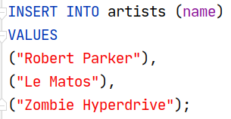
Create
Bulk inserts are useful for inserting lots of data
Data imports that are executed as one-at-a-time INSERTs can be very slow
This insert is a single transaction
It either all works or all fails
Notes:
Can be found online… but I can’t link to it

Slide 8
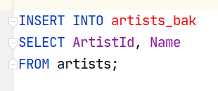
Create
You can also insert the values of SELECT statements
Columns will be matched by name
You can use aliasing if you need to
This is useful in situations when you are doing administrative work
Fun LeadDyno Story Time!
Notes:
Can be found online… but I can’t link to it

Slide 9
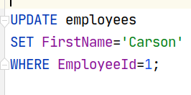
Update
Updating data in SQL is done with the UPDATE statement
The basic form is UPDATE <table> SET <col1>=<val1>, <col2>=<val2>, ... WHERE <conditions>;
Notes:
Can be found online… but I can’t link to it

Slide 10

Update
Careful, you don’t want to forget the WHERE clause!
Lucky for you you have an instructor who likes you and wants you to be happy…
ResetDB.java
Notes:
Can be found online… but I can’t link to it

Slide 11
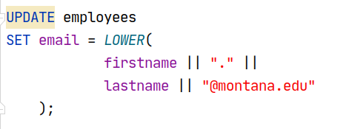
Update
Bulk updates do sometimes happen
Often are computed updates as shown
The || operator means “string concatenate” in SQLite, Oracle and a few other DBs
NOT STANDARD
Notes:
Can be found online… but I can’t link to it

Slide 12

Delete
DANGER WILL ROBINSON DANGER
Deleting data is a dangerous action
Can lead to referential integrity violations
Often better to have a boolean ‘archived’ column
Notes:
Can be found online… but I can’t link to it

Slide 13
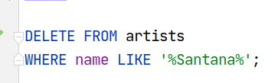
Delete
General form is DELETE FROM <table> WHERE <condition>
Demo IJ preview functionality
Notes:
Can be found online… but I can’t link to it

Slide 14
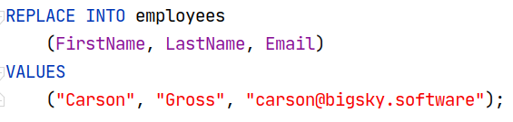
Replace/Upsert
This is a SQLite specific statement
Replaces any existing rows that violate a uniqueness constraint with the new data
If no rows violate a uniqueness constraint, the row is INSERT-ed instead
Notes:
Can be found online… but I can’t link to it

Slide 15
Replace/Upsert
Syntax: REPLACE INTO <table> (<col1>, <col2>, …) VALUES (<val1, val2, …)
This is a variation of the UPSERT pattern (aka MERGE)
Notes:
Can be found online… but I can’t link to it

Slide 16
Replace/Upsert
See the Merge(SQL) page on Wikipedia https://en.wikipedia.org/wiki/Merge_(SQL)#upsert
This operation is very common with NoSQL databases
What are its advantages?
Notes:
Can be found online… but I can’t link to it

Slide 17
Replace/Upsert
Upserts are not standard in SQL and some databases have varying levels of support and correct behavior for it
SQLServer Rant: https://sqlperformance.com/2020/09/locking/upsert-anti-pattern
Notes:
Can be found online… but I can’t link to it

Slide 18
Data Mutation Summary
Today we learned the C, U and D of CRUD
Create with the INSERT statement
We learned how to get the generated key after an insert occurs
Useful for the project!
Update with the… UPDATE statement
Delete, if you must, with the DELETE statement
We also learned about Upserts, a newer and non-standard pattern for inserting or updating data into a database

